Slide 1
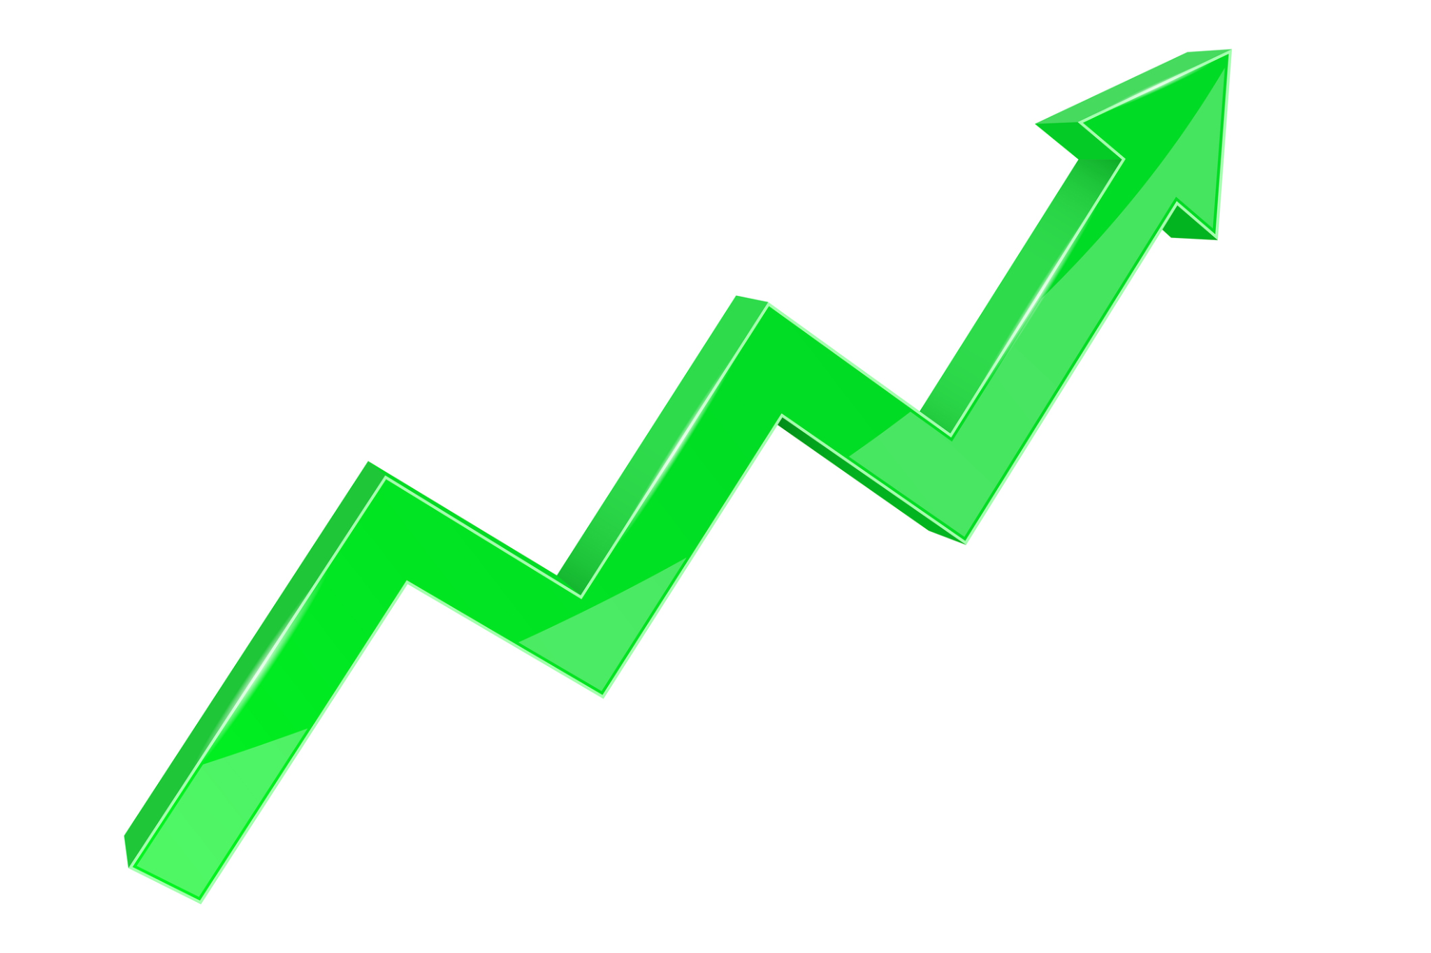
Neural Networks Trading Algorithm
Chadwick Sanon, David Kratzer, Josh Bazzano, Miguel Suarez

Slide 2
Executive Summary

Slide 3
Concept
Algorithmic trading using deep learning and neural networks to predict next day price
Long only strategy with no shorting
RNN vs FNN
LSTM Neural Network with fear and greed index features
Visualize model training
Hyper optimization of model parameters using Optuna
Backtest model predictions
Modular structure i.e. use of classes and functions

Slide 4
Data Resources & Preparation
Data is retrieved from Yahoo Finance and transformed into a dataframe and normalized
Data is trained for 50 epochs standard, but can be adjusted by the user
Backtesting is done to generate signals and feeding the signals into the model

Slide 5
Approach
Data gathering
Preprocessing
Model training
Model saving
Model Evaluation
Signal Generation
Backtesting strategy
Parameter optimization

Slide 6
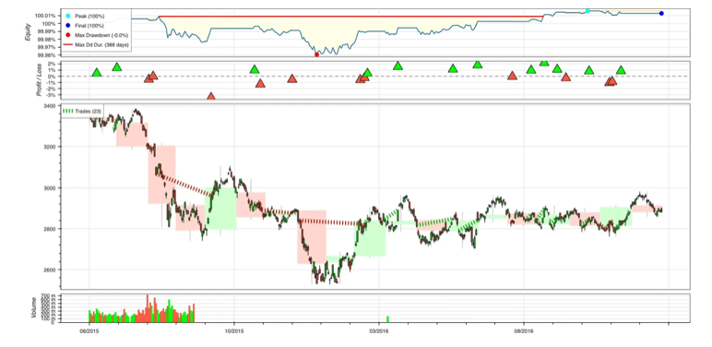

Slide 7
Next Steps
Changing the number of epochs
Adding dropout layers
Changing the optimization algorithm
Stock implementation
Experimenting with deep reinforcement learning and transformer models
Turning the trading bot on and making money

Slide 8
Installation Guide
Clone the Repo
Install the dependencies.
Dependencies
Datetime
Pandas
Numpy
Finance
Tensorflow
Sklearn
IPython
Backtesting
Keras

Slide 9
Links
https://substack.com/home/post/p-146438163
https://github.com/Joshbazz/Neural_Network_Project_2

